Slide 1
More Than Just an Equipment Company,
We Provide Solutions!
Notes:
Introductions

Slide 2
History
Founded in 1946
Custom precision masking
Invented solvent-less mask washer
70’s Automated masking equipment
80’s Custom built finishing systems
90’s Focus on automated finishing systems
Robotic application experts – 5x Fanuc IOY
PreTreatment and Cleaning expertise
2003 new 84,000 sq/ft Mfg facility in G.R.
2014 new 20,000 sq/ft Mfg in Monterrey, MX
Built not bought!
Modular equipment approach
Patented water wash design
Energy savings initiatives

Slide 3
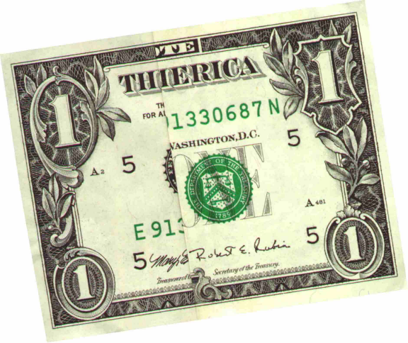
Our Name
Notes:
Two brothers returning from the war feeling patriotic, the united states of america

Slide 4
EQUIPMENT GROUP
DECORATING GROUP
THIERICA DE MEXICO
THIERICA EQUIPMENT COMPANY

Slide 5
Commercial Aspects
Privately held company with a strong financial position
Diversified offerings establishing market stability
Company wide annual sales of $50 million
Company wide work force of 200+ employees
Niche market focused on custom processes and equipment
Global market presents in over 10 countries
Four manufacturing facilities in North America
Notes:
China, Korea, Mexico, Canada, Brazil, Argentina, Portugal, Hungary, England, Ireland

Slide 6
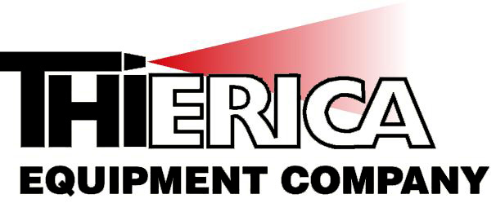
The Difference -Because of what we do…
Both in Grand Rapids and Monterrey we:
Design and manufacture equipment in house
Mechanical Design, Controls Design, Robot Programming all in house
In house run off of all equipment prior to shipment
Modular robust construction
Single point contact project management
24 hr service and support after the sale

Slide 7
Industries served…
Interior and Exterior Automotive Plastics
Consumer Electronics
General Industrial Products – Metal, Plastic, Composite
Aerospace
Sporting Goods
3D Wood Products
Power Generation
Notes:
Longenberger, assembled chairs Hole saws, oil rig piping, air motors Nuclear process piping, windmill blades,

Slide 8
Sample of Completed Projects (Robotic)
Various Interior Car Parts
Airplane Landing Gear
Custom Valves weighing up to 5000 lbs.
Diving Boards – Powder, Sand, Epoxy
Missile Defense Antenna(s)
Football Helmets
Wood Chairs
Notes:
Longenberger, assembled chairs Hole saws, oil rig piping, air motors Nuclear process piping, windmill blades,

Slide 9
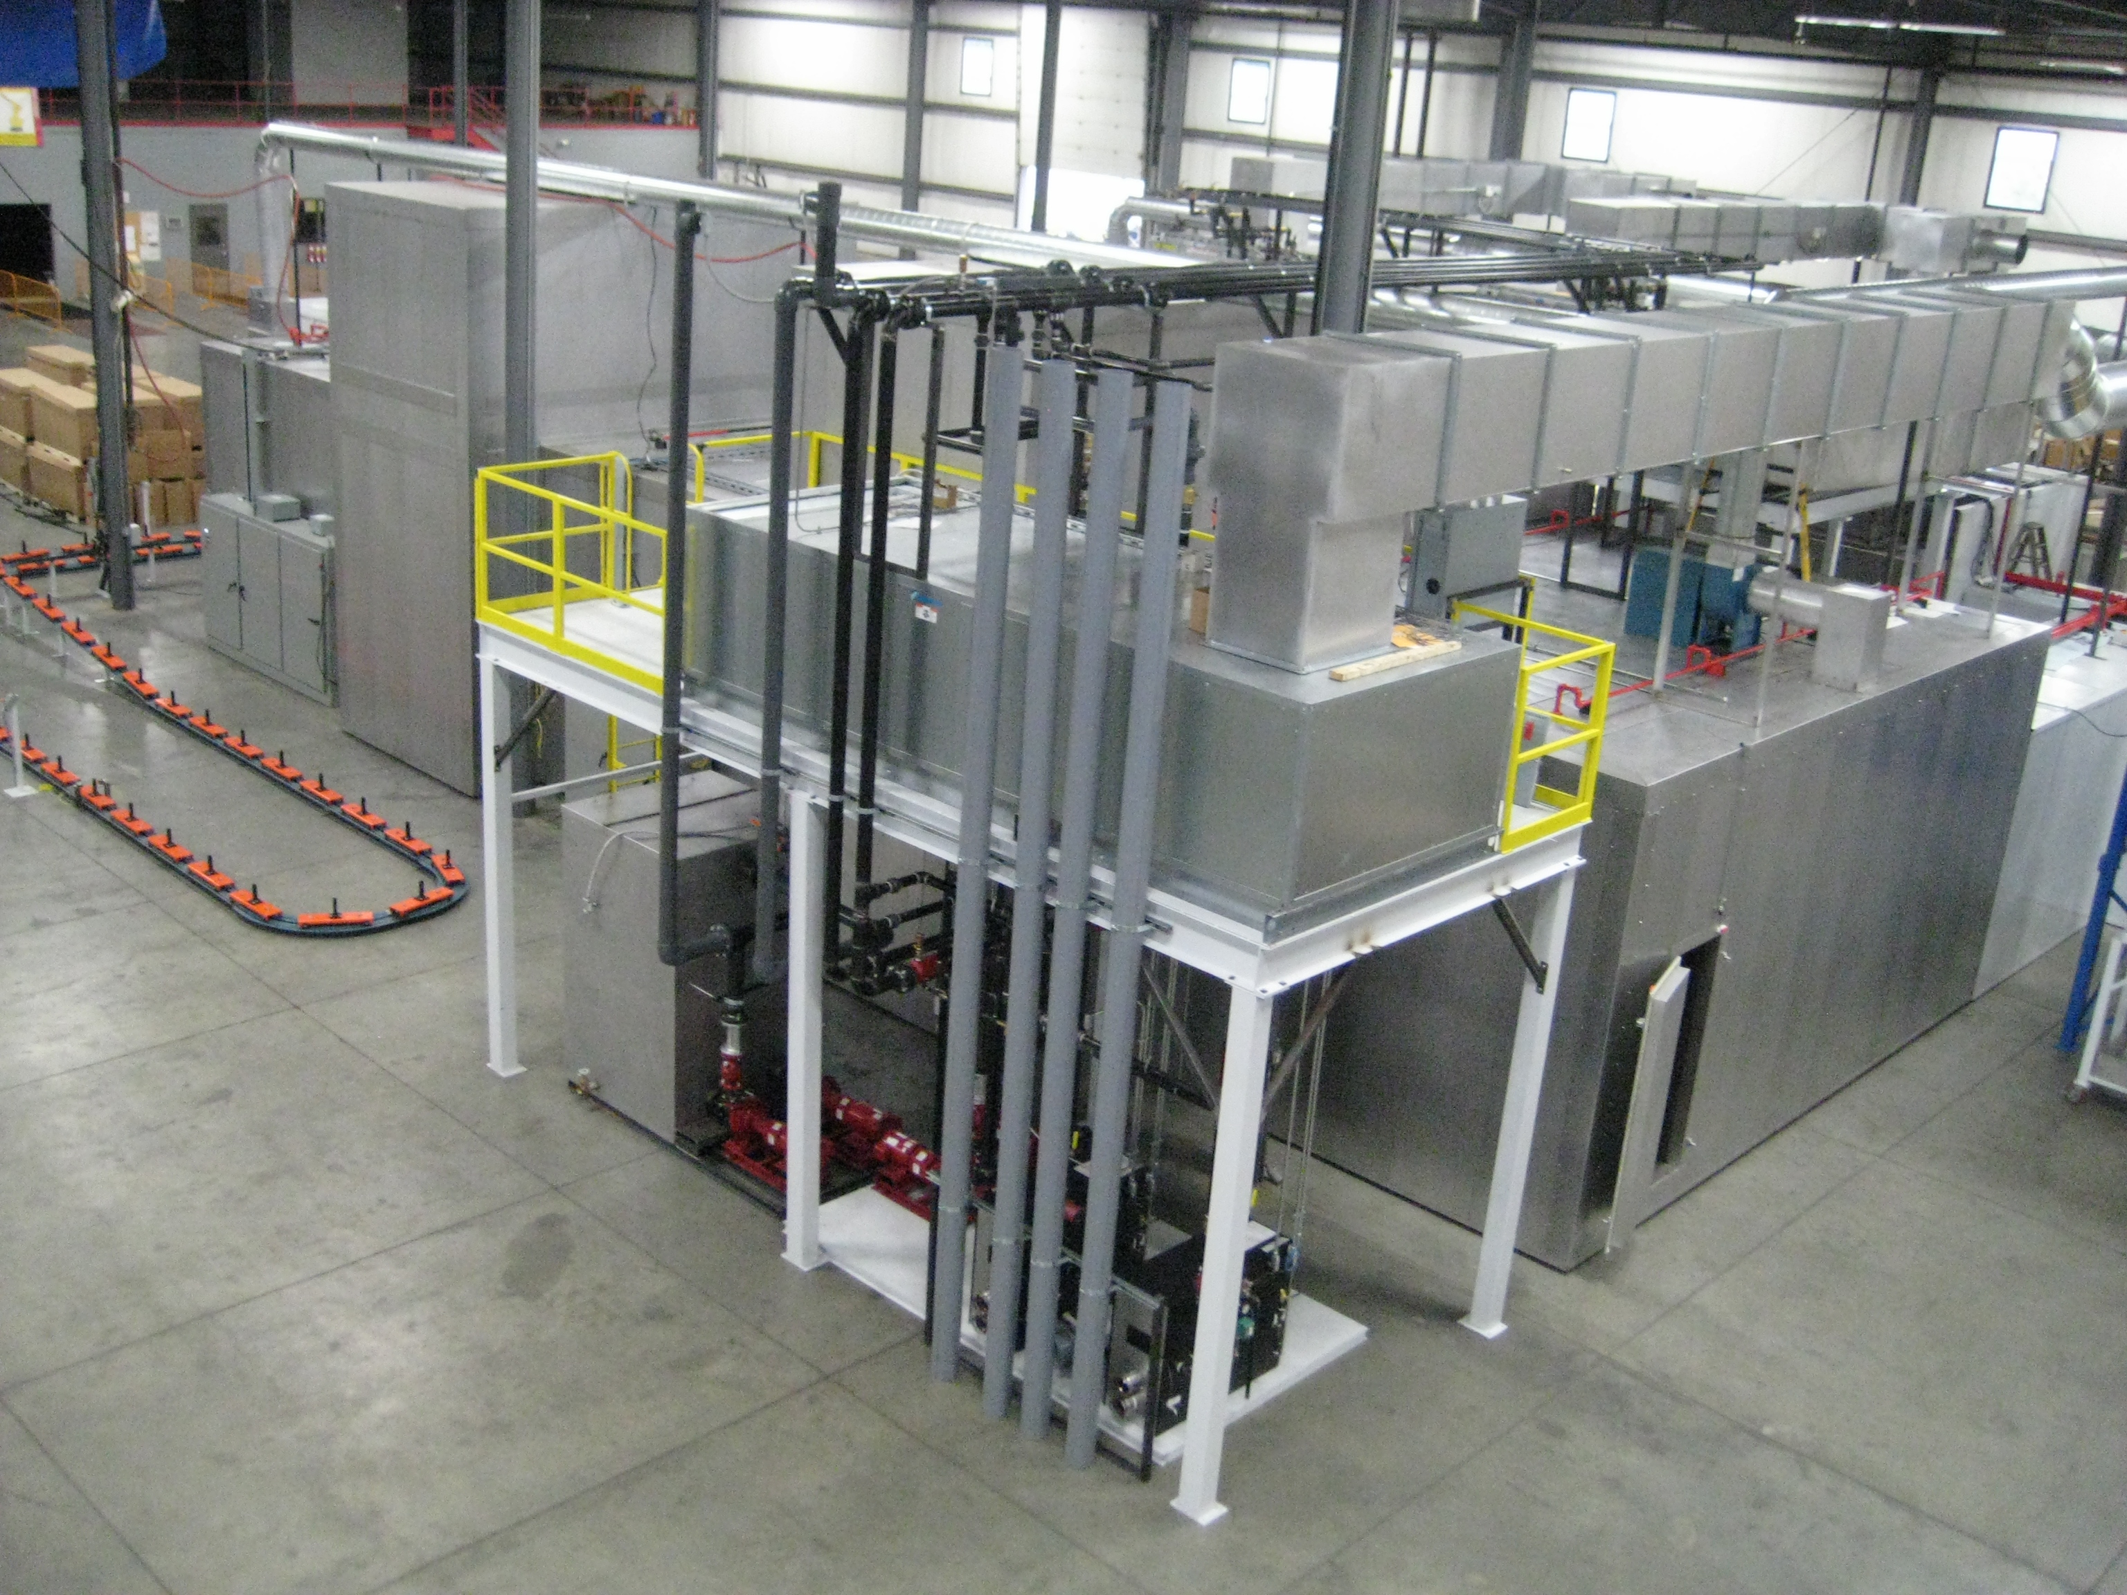
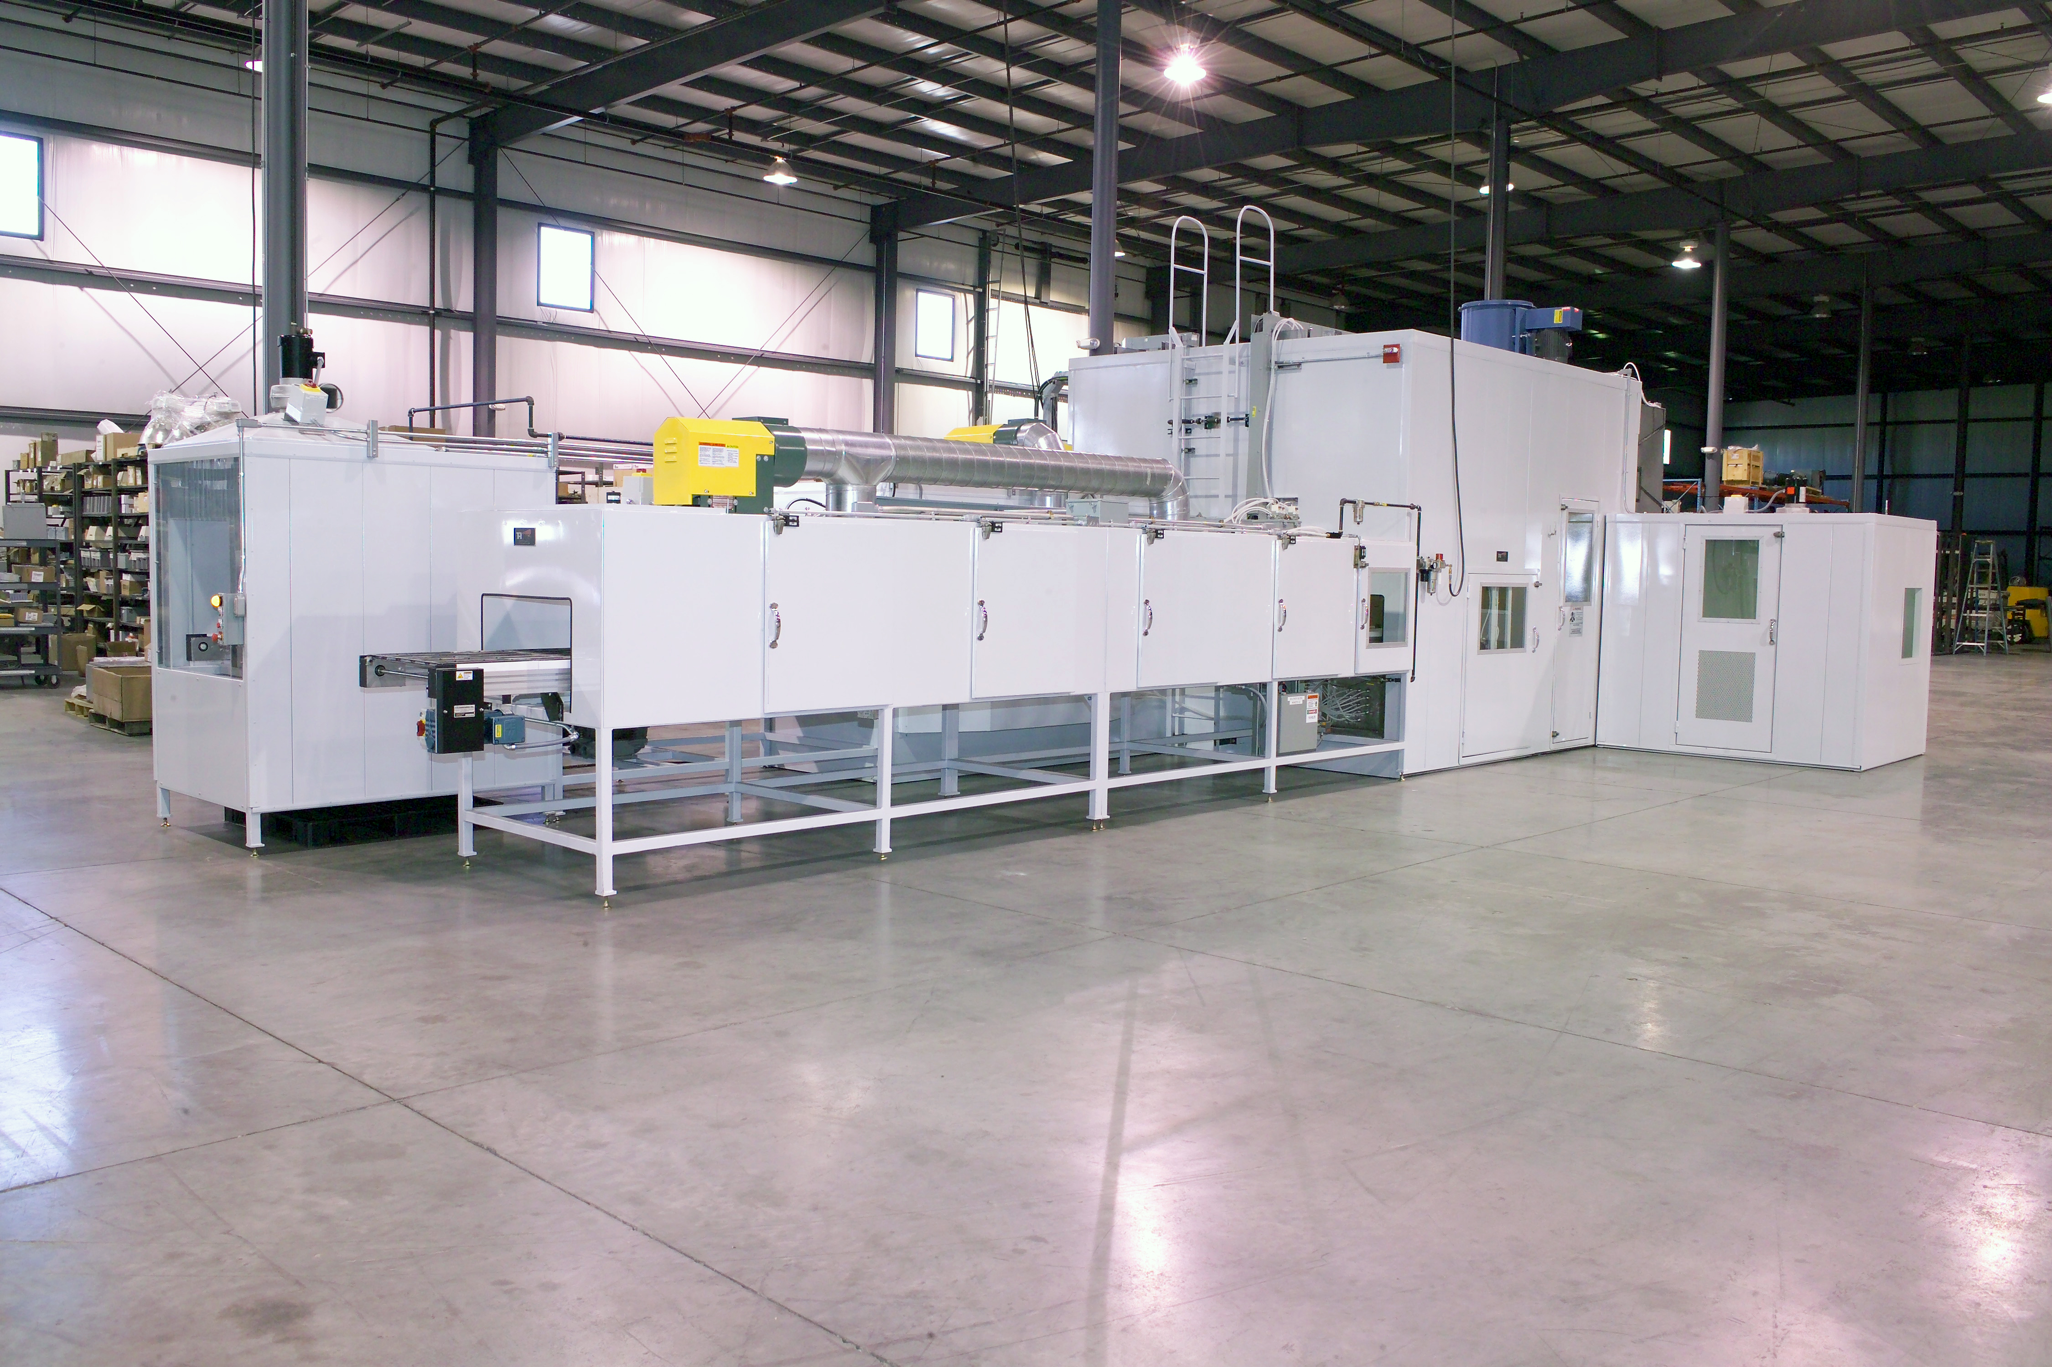
SYSTEM SIZES WE BUILD
From Large Automated Systems
$2-12 million
To Smaller Individual Automated Cells
$50-500 thousand
Notes:
Large systems have been multi phased projects similar to this one

Slide 10
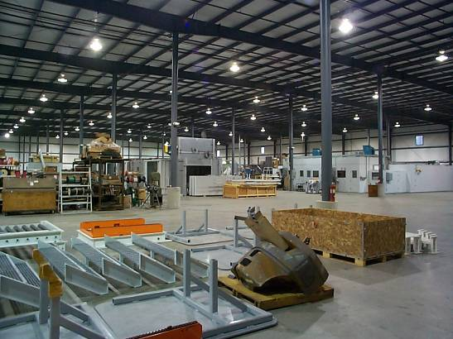
Thierica Difference
Thierica assembles your system in our 84,000 sq. ft. facility and proves it out before we install at your site.

Slide 11
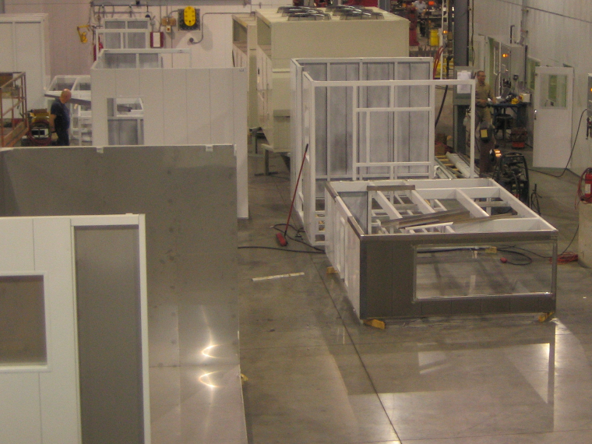
Quality Construction
Welded Steel Base Frame
Coated Exterior Panels
Stainless Steel Skinned Interior
Notes:
Reuse system frames!!

Slide 12
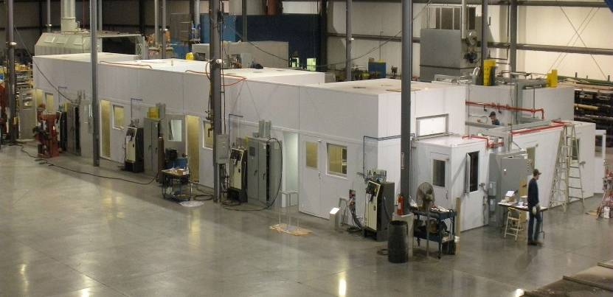
Automated Robotic Painting System

Slide 13
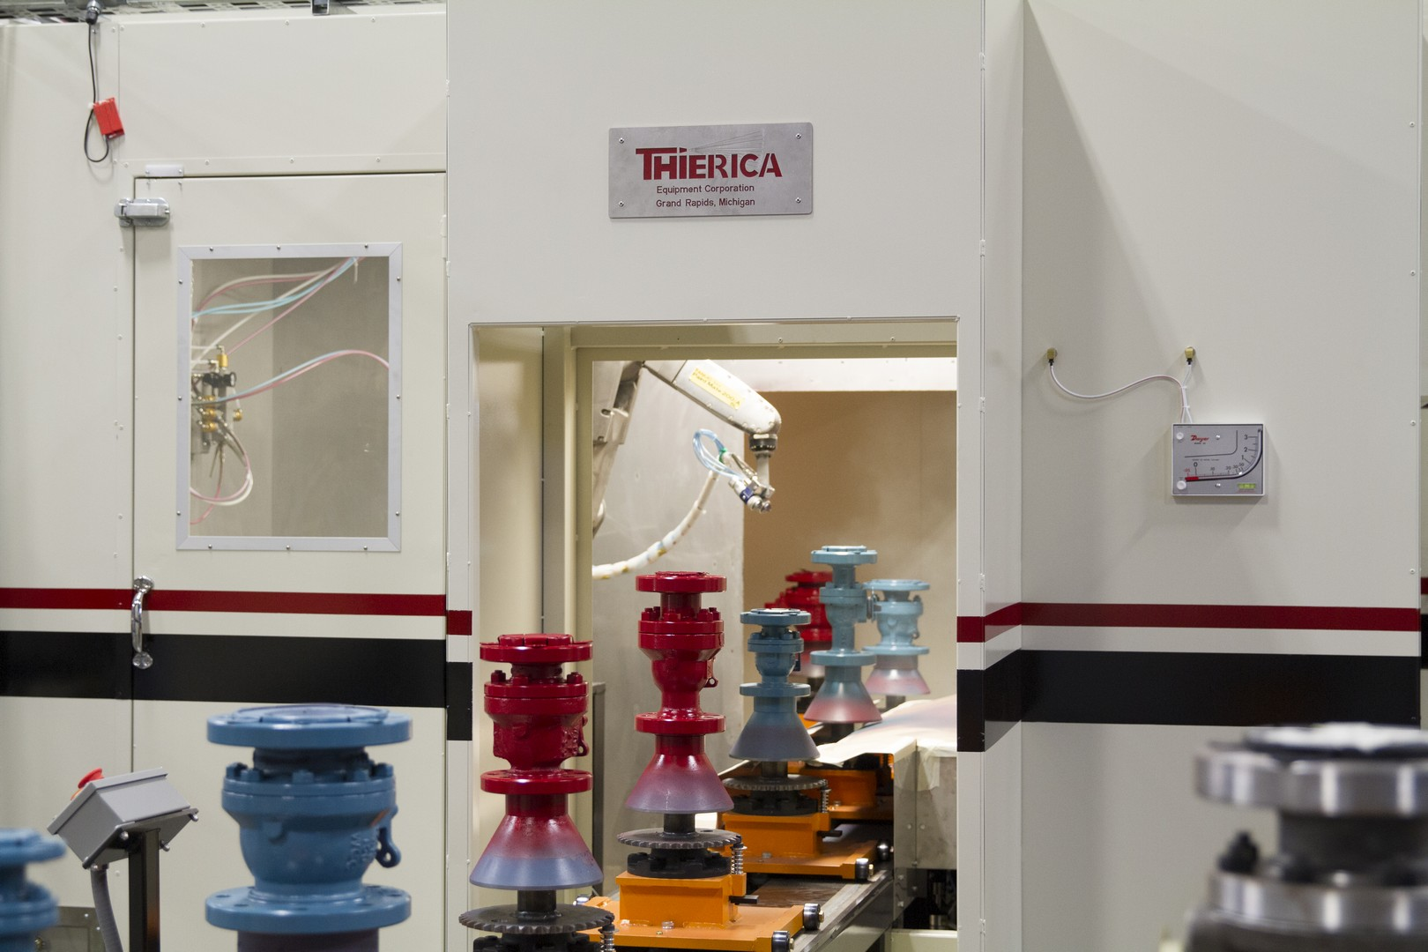
Samples Before Delivery
The Comfort of Running Sample Parts During Pre-Qualification

Slide 14
Unique Solutions
Compact Fanuc Wall Mounted Robot
Palletized Design Concept

Slide 15
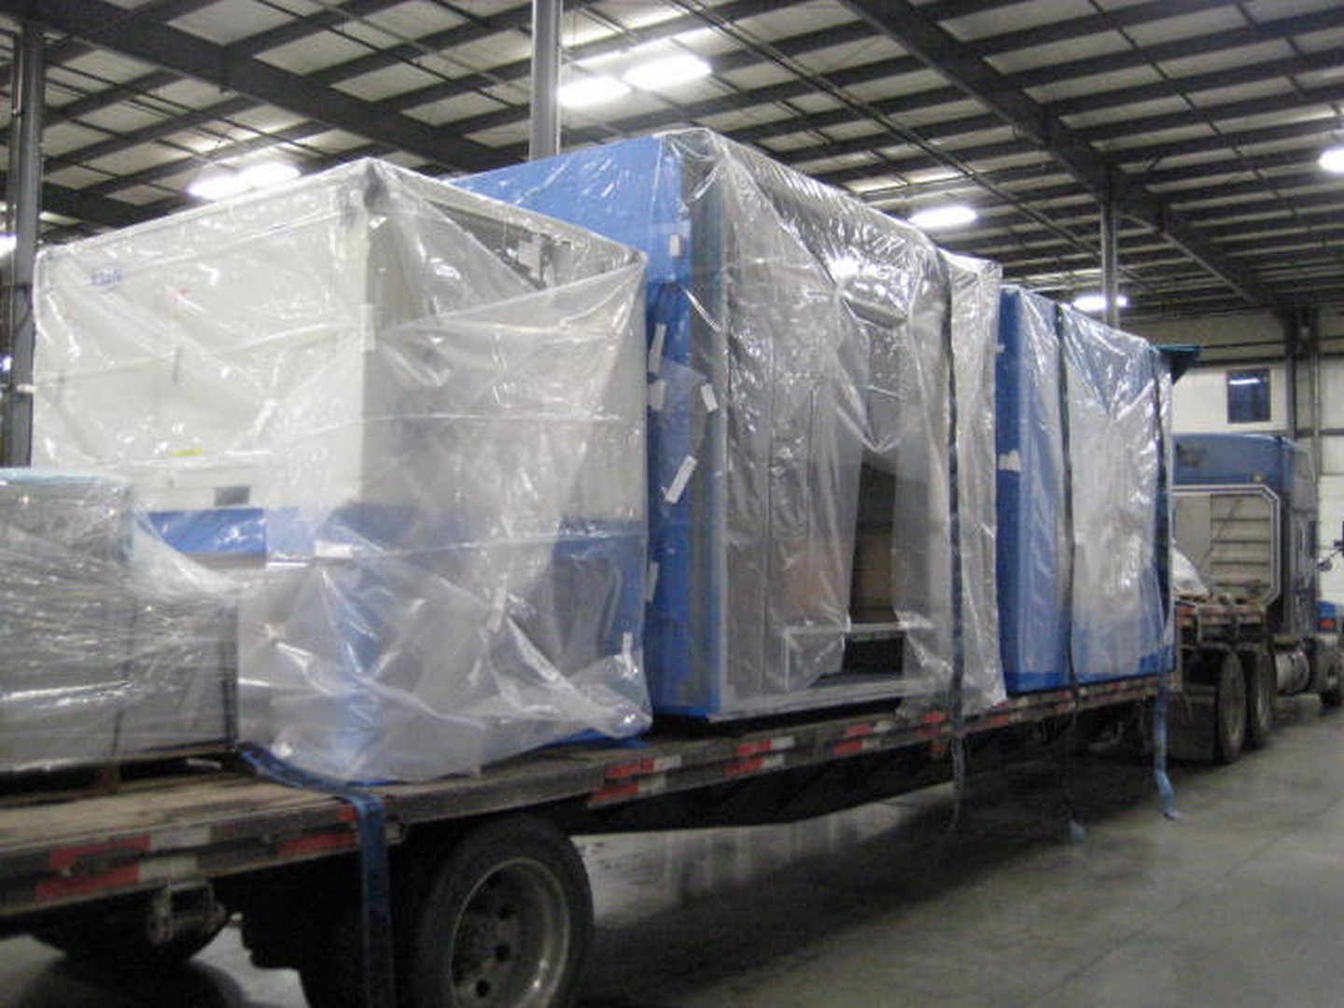
Modular Construction
Modules Built to Fit Standard Flat Bed

Slide 16
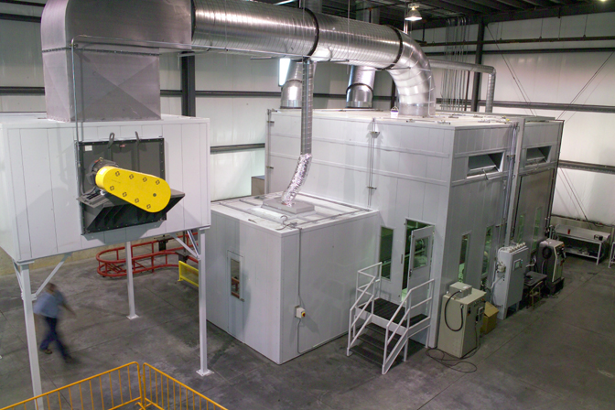
Testing Lab

Slide 17
Confirm Cost Justification

Slide 18
Our Sales Team
Dominic Zerilli – Sales Manager
Dave Kooienga – Sales Engineer
Darin Hibbs – Sales Engineer

